Slide 1


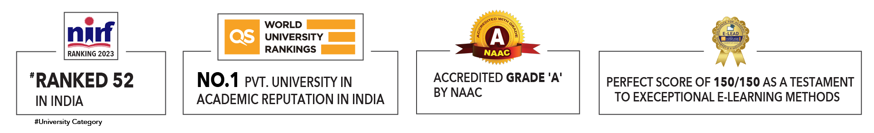

Slide 2

Unit 1 : Introduction to Operating System
Lecture 5
Dr. Hemant Petwal
School of Computer Science UPES, Dehradun
India

Slide 3
Table of Contents
Operating System Operations

Slide 4
Learning & Course Outcomes
Learning Outcomes
LO1: Understand the Operations of Operating System
Course Outcomes
CO1: Demonstrate a comprehensive understanding of operating systems

Slide 5
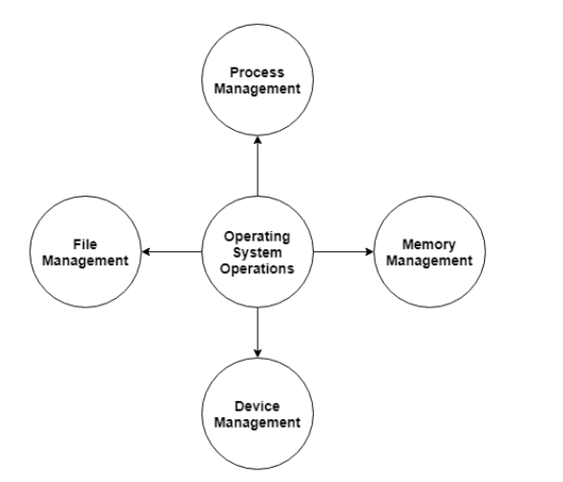
Operating System Operations
An operating system allows the user application programs to interact with the system hardware. Operating system by itself does not provide any function but it provides an atmosphere in which different applications and programs can do useful work.
The major operations of the operating system are:
Process management
Memory management
Device management
File management.
Fig 1. Operating System Operations

Slide 6
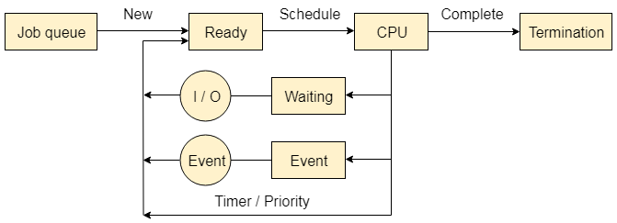
Operating System Operations
Process Management
The operating system is responsible for managing the processes i.e assigning the processor to a process at a time. This is also known as process scheduling.
The different algorithms used for process
scheduling are:
FCFS (first come first served),
SJF (shortest job first),
priority scheduling,
round robin scheduling etc.
There are many scheduling queues that are used to handle processes in process management.
When the processes enter the system, they are put into the job queue.
The processes that are ready to execute in the main memory are kept in the ready queue. The processes that are waiting for the I/O device are kept in the device queue.
Fig 2. Process Management

Slide 7
Operating System Operations
Memory Management
Memory management plays an important part in operating system. It deals with memory and the moving of processes from disk to primary memory for execution and back again.
The activities performed by the operating system for memory management are
The operating system assigns memory to the processes as required. This can be done using best fit, first fit and worst fit algorithms.
All the memory is tracked by the operating system i.e. it nodes what memory parts are in use by the processes, and which are empty.
The operating system deallocated memory from processes as required. This may happen when a process has been terminated or if it no longer needs the memory.

Slide 8
Operating System Operations
Device Management
There are many I/O devices handled by the operating system such as
mouse,
keyboard,
disk drive etc.
There are different device drivers that can be connected to the operating system to handle a specific device.
The device controller is an interface between the device and the device driver.
The user applications can access all the I/O devices using the device drivers, which are device specific codes.

Slide 9
Operating System Operations
File Management
Files are used to provide a uniform view of data storage by the operating system. All the files are mapped onto physical devices that are usually non-volatile so data is safe in the case of system failure.
The files can be accessed by the system in two ways
Sequential access
Direct access

Slide 10
Operating System Operations
File Management
Sequential Access The information in a file is processed in order using sequential access. The files records are accessed one after another. Most of the file systems such as editors, compilers etc. use sequential access.
Direct Access In direct access or relative access, the files can be accessed in random for read and write operations. The direct access model is based on the disk model of a file, since it allows random accesses.

Slide 11
MCQ
Q1. What is the main purpose of process management in an operating system?
A. Managing files on the disk B. Managing memory allocation
C. Assigning the processor to a process at a time D. Managing network connections
Q2. Where are processes kept when they enter the system?
A. Ready queue B. Device queue
C. Job queue D. Exit queue
Q3. What is the role of device drivers in an operating system?
A. Manage memory allocation B. Manage file systems
C. Allow the operating system to communicate D. Handle process scheduling
with hardware devices
Q4. What is sequential access in file management?
A. Accessing files in a random order B. Accessing files one after another in order
C. Accessing files by their index D. Accessing files by their physical location on disk

Slide 12
MCQ
Q5. What is the function of the device controller in device management?
A. Manages file systems B. Acts as an interface between the device and device driver
C. Allocates memory to processes D. Handles process scheduling
Q6. What does the operating system do when a process no longer needs memory?
A. Allocates more memory to the process B. Deallocates memory from the process
C. Moves the process to the job queue D. Suspends the process
Q7. Which of the following best describes file management in an operating system?
A. Managing user passwords B. Handling the storage, retrieval, and update of data on disk
C. Managing network connections D. Allocating memory to processes

Slide 13
MCQ
Question No- Answer | Option | Description
Q1- Answer | C | Assigning the processor to a process at a time
Q2- Answer | C | Job queue
Q3- Answer | C | Allow the operating system to communicate with hardware devices
Q4- Answer | B | Accessing files one after another in order
Q5- Answer | B | Acts as an interface between the device and device driver
Q6- Answer | B | Deallocates memory from the process
Q7- Answer | B | Handling the storage, retrieval, and update of data on disk

Slide 14
Summary/Key Points
An operating system allows the user application programs to interact with the system hardware.
The major operations of the operating system are
Process management
Memory management
Device management
File management.
Process management is responsible for managing the processes i.e assigning the processor to a process at a time. This is also known as process scheduling.
Memory management deals with memory and the moving of processes from disk to primary memory for execution and back again.
Device management is responsible to for device drivers that can be connected to the operating system to handle a specific device.
File management is responsible for communication between files and data storage by the operating system

Slide 15
Reference Material
Operating Systems Concepts (10th Ed.) Silberschatz A, Peterson J and Galvin P, John Wiley & Sons, Inc. 2018.
Topic:
Operating System Operations, Page No: 21-27
Modern Operating Systems (4th Ed.) by Andrew S. Tanenbaum and Herbert Bos, 2007
Operating Systems: Principles and Practice by Thomas Anderson and Michael Dahlin, 2014

Slide 16
Coming Up-Next Lecture
System boot
System Calls
Types of System Calls (Windows and Unix System Calls examples),
Open-Source Operating Systems

Slide 17

Thank You

